Slide 1

HYPERTENSION PREVENTION AND CONTROL MANUAL FOR COMMUNITY HEALTH CARE WORKERS
MINISRY OF HEALTH, THE GAMBIA
PRESENTER’S NAME:

Slide 2
Components of a course description
Title of the module
Overall/general objective
Specific objectives of the module
Unit titles and subtopics
Course plan guide; units, titles, teaching methods, teaching aids and time per unit
References and recommended readings for the module

Slide 3
Table of Contents
Unit 1: Understanding the Meaning of Hypertension
How our blood moves
The heart as a pump
Understanding blood pressure
Normal blood pressure
Low blood pressure
High blood pressure
Understanding hypertension
Define hypertension
Why is it important to understand hypertension?
Is hypertension a problem in The Gambia?

Slide 4
Unit 2: Identify the risk factors of hypertension
What is a risk factor?
Risk factors for hypertension
Unit 3: Measure and interpret blood pressure readings
Understand the tools for measuring blood pressure
How to measure blood pressure
Interpretation of the readings
Practice session on measuring blood pressure
Unit 4: Education to the community on prevention and management of hypertension
How to prevent and lower high blood pressure
Lifestyle modification

Slide 5
Unit 5: Facilitating the management of hypertension
Identifying and managing cases of hypertension
Referral
Follow-up
Adherence
Defaulter tracing
Unit 6: Reporting
Orientate participants on data collection tools
Submit monthly reports to the sub-district leader

Slide 6
Objectives
Overall/general objective
To equip the participants with knowledge and skills to prevent, screen, refer and follow-up clients with hypertension in the community.
Specific Objectives
By the end of this orientation the participants will be able to:
Explain the meaning of hypertension
Identify the risk factors of hypertension.
Measure and interpret blood pressure readings
Educate the community on prevention and management of hypertension
Facilitate management of hypertension through referral and follow-up
Training Duration
2 Days

Slide 7
Teaching/Training Methodologies
Buzzing
Brainstorming
Group work
Lectures
Questions and answers
Case studies
Discussions
Demonstrations and return demonstrations
Training Materials
Flipcharts
Marker pens
Writing paper
Pens
Visual aids
Checklist
Blood pressure machines
Referral booklets

Slide 8
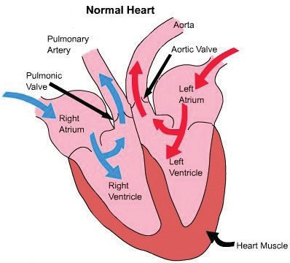
UNIT 1
Understanding the Meaning of Hypertension
Duration: 2 hours
1. How our Blood Moves
Our blood circulation includes the heart, the blood and blood vessels. Circulation means to move around.
The heart works like a water pump and blood vessels are like tubes or small water pipes that carry blood around the body.
2. What is blood pressure?
Blood pressure is the pressure of blood in your blood vessels (arteries) when the heart is contracting and relaxing.
Our blood pressure changes depending on the activities we are doing. If we are running the blood pressure will be high, if we are resting or asleep the blood pressure will be lower

Slide 9
3. Understanding Blood Pressure
Blood pressure is typically recorded in mm Hg as two numbers, written as a ratio like this for example:
120
70
mmHg
The top number, which is also the higher of the two numbers, is called systolic and it measures the pressure in the arteries when the heart beats (when the heart muscle contracts).
The bottom number, which is also the lower of the two numbers, is called diastolic and it measures the pressure in the arteries between heartbeats (when the heart muscle is resting between beats and refilling with blood).
Normal blood pressure
The blood pressure is normal when the top number (systolic) is lower than 140 and the lower number (diastolic) is lower than 90
Low blood pressure
The blood pressure is considered low when the top number (systolic) is lower than 90 and the lower number (diastolic) is lower than 60, with symptoms of low blood pressure such as dizziness or fainting. Other causes of low blood pressure include medicines, bleeding, aging and conditions such as dehydration.

Slide 10
High blood pressure
The blood pressure is high when the top number (systolic) is 140 or higher and the lower number (diastolic) is 90 or higher.
Note: Our blood pressure changes depending on the activities we are doing. If we’re running the blood pressure will be high, if we’re rest- ing the blood pressure will be lower
Define hypertension
Hypertension is diagnosed when blood pressure is equal to or greater than 140/90 mmHg on three separate occasions.
Why is it important to understand hypertension?
In reference to the water pump (heart) illustration given earlier; when the pressure is too high the water pipes (blood vessels) could burst, the pump might break or the tap could come off (the impact on other organs e.g. eyes, kidneys, brain).
The risk of this happening increases if the person is smoking, according to age, or is overweight.

Slide 11
Is hypertension a problem in in The Gambia?
How many participants have measured their BP this month??
The prevalence of hypertension in 29% (cham et al)
Studies in older populations report prevalence rates of >20%
Participants to discuss trends observed in their facilities
Brainstorm on possible reasons why these trends exist
How many of you have given a talk on hypertension this year?

Slide 12
Signs and symptoms of hypertension
Hypertension is a silent disease – Most people do not have any symptoms
However, a few people may develop the following:
Headache
Fatigue or confusion
Visual problems
Chest pain
Difficulty in breathing
Irregular heartbeat
Blood in the urine
Awareness of heartbeats (pounding in the chest, neck, or ears)
Activity: 1
Signs and symptoms
GROUP WORK: 15 minutes
Divide the participants in groups of 5
Let them discuss the signs and symptoms of hypertension
(10 minutes)
Discuss the group work results in a plenary session (5 minutes)

Slide 13
Myths and Misconceptions
Hypertension can be cured (by herbal medication)
It only occurs in overweight and obese
Disease for the rich/ affluent
If no symptoms, no hypertension
You cannot get it if it is not in your family
It’s a result of a curse
For only the elderly
Myths and misconceptions
Activity: 2
Brainstorming session: 15 Minutes
The participants to discuss on common beliefs and perceptions about hypertension in their communities
The trainer lists the suggestions from the participants
The facilitator clarifies truths, myths and misconceptions

Slide 14
UNIT 2
Identify the risks of hypertension
Activity: 1
Duration: 2 hours
Risk factors
1. What is a risk factor?
A risk factor is a condition or behavior that increases a person’s chance of developing a disease.
Risk factors for hypertension include health conditions, lifestyle and family history
There are risk factors that we can do something about and others that we can not do anything about
Brainstorming session: 15 Minutes
Brainstorm on the risk factors of hypertension
The facilitator lists the responses from the participants
Ask the participants which risk factors can be changed and which ones cannot changed
The facilitator clarifies the risk factors using the slides

Slide 15
Non modifiable (not changeable) risk factors for hypertension
Advancing age
Family history of hypertension
Chronic conditions e.g. diabetes mellitus, kidney diseases, heart disease
Pregnancy
Race
Modifiable (changeable) risk factors for hypertension
Being overweight
Physical inactivity
Use of tobacco
Stress
Drinking excess alcohol
Unhealthy diet
Excessive salt intake
i. Being overweight
The more you weigh, the harder the heart needs to pump blood to the whole body, hence the higher the pressure on the walls of the blood vessels. Overweight can be estimated by measuring the waist circumference or the weight to height ratio, referred to as the Body Mass Index (BMI).

Slide 16
ii. Advancing age
The older you get, the stiffer the blood vessels become, hence the higher the risk of hypertension.
iii. Unhealthy diet
Being overweight or obese, can contribute to more fat in the body including the blood vessels
A diet low in fruits, vegetables and fiber and high in fats, salt and refined carbohydrates will increase the risk of hypertension, heart disease and stroke
iv. Physical activity
Physical activity refers to any bodily movement which uses energy and is performed as part of daily activities
Physical activity exercises the heart and the blood vessels to work well
Physical activities help to reduce weight and blood sugar levels
v. Family history of hypertension
The risk of hypertension is higher among people with family members with hypertension
vi. Use of tobacco
Tobacco use (e.g. cigarette smoking, shisha etc.) makes blood vessels stiff and narrow, therefore restricting free flow of blood
The chemicals in tobacco raise blood pressure and damage the blood vessels.

Slide 17
vii. Stress
Stress temporarily raises the blood pressure
Stress can lead to other behaviours that contribute to developing hypertension e.g. smoking, alcohol use
viii. Drinking alcohol
Alcohol intake weakens the heart, it increases weight and cholesterol
ix. Excessive salt intake
Taking more salt increases water retention in the body, which causes high blood pressure.
Reducing salt intake is beneficial for blood pressure prevention and control.
x. Chronic conditions e.g.. diabetes, kidney disease
These conditions can lead to increased blood pressure
xi. Pregnancy
Changes that occur during pregnancy can lead to hypertension. Therefore it’s important to go for ANC

Slide 18
UNIT 3
How to measure and interpret blood pressure readings
Duration: 2 hours
Tools for measuring blood pressure
We measure blood pressure with an instrument called sphygmomanometer (Sphyg.): a blood pressure machine.
There are two kinds of monitors for measuring blood pressure
Manual (mercury and aneroid)
Automatic - (digital)

Slide 19
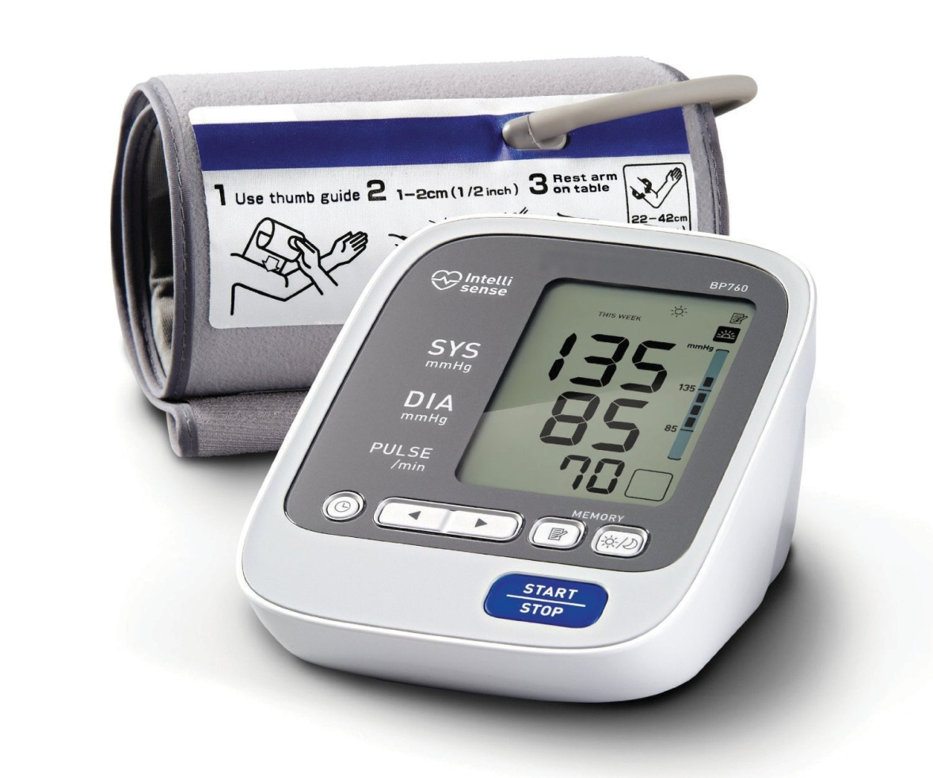
The Automatic Blood Pressure (BP) Machine
The Automatic Blood Pressure (BP) Machine
Features of the Blood Pressure Machine
A BP machine typically has three parts: the cuff, a pump attached to the cuff by a tube, and a dial or screen that is also attached to the cuff by a tube.
The cuff, which is like a wide strap, wraps snugly around your arm above the elbow. The cuffs may come in different sizes.
How to measure blood pressure
Let the client rest for 3 - 5 minutes
The client should not have taken any drink with caffeine e.g. coffee, tea or cool/energy drink or smoked in the previous 30 minutes
Sit the client in a relaxed, upright position; with the legs and arms out- stretched
Select the appropriate size of cuff
Arm BP machine

Slide 20
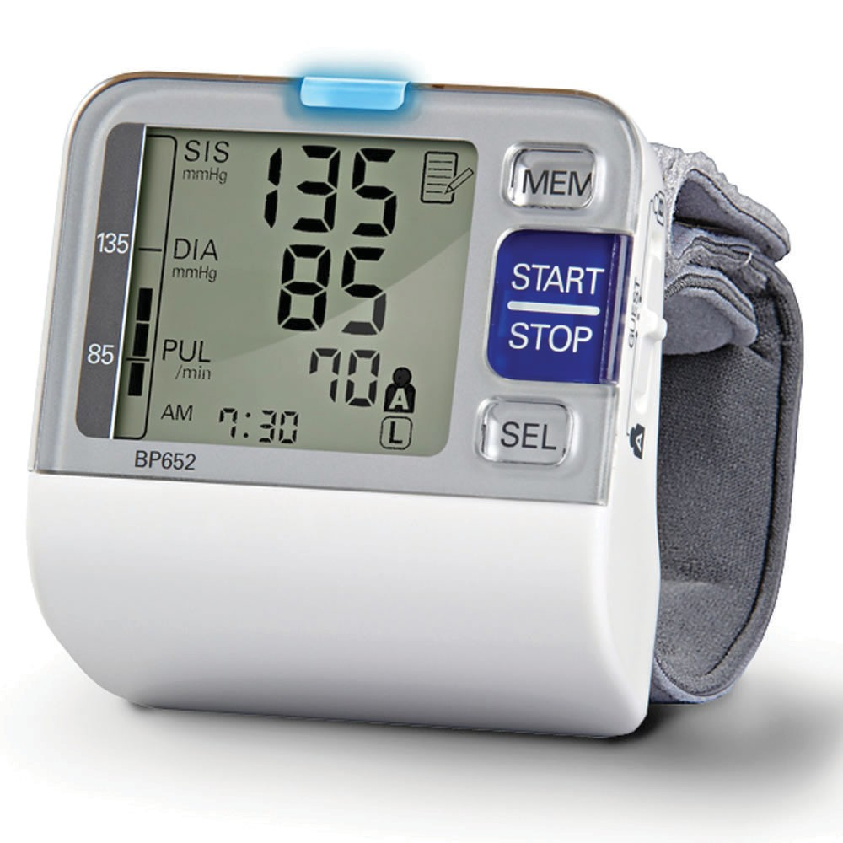
The arm should be supported at the level of the heart.
Wrap the cuff around the client’s left arm to measure the blood pressure (In cases where the left arm can’t be used, use the right arm).
When you tighten the cuff on the arm you should be able to insert two fingers under the cuff
Press the start button on the automatic BP machine and observe the readings when the machine beeps
Note the first reading and repeat the procedure after two minutes
Record the second reading of the two taken
The facilitator should demonstrate the procedure to the participants
Wrist BP machine

Slide 21
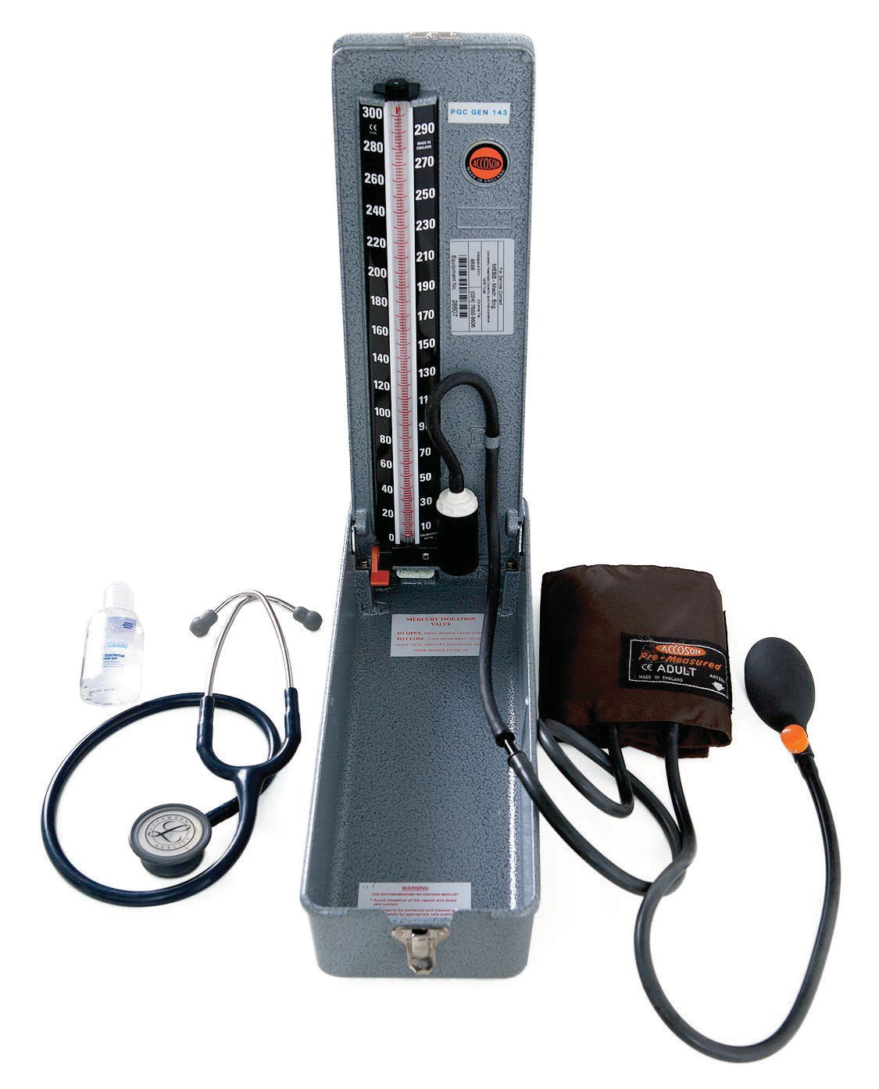
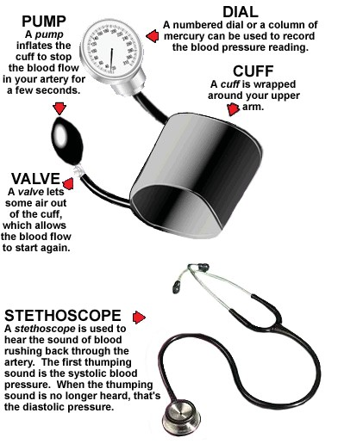
Manual Blood Pressure Monitor

Slide 22
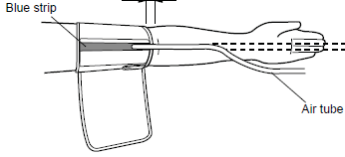
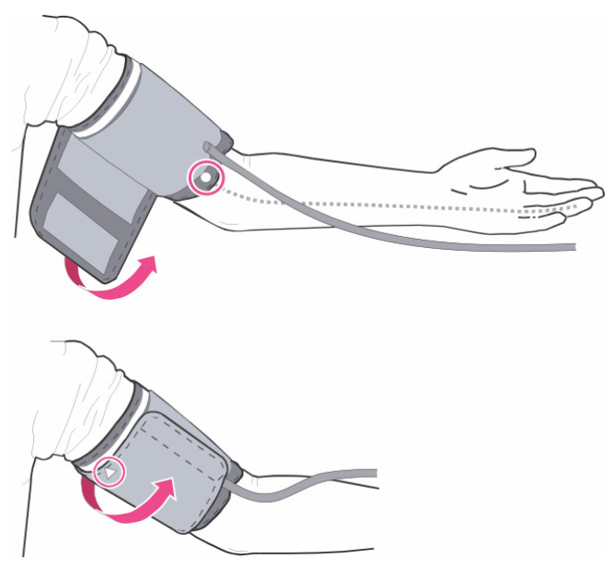
The cuff should be placed with the bladder midline over the brachial artery pulsation
Blood Pressure Measurement
Action | √ | Comments
Consent and Explanation
Allow patient to rest for 5 minutes if seated, 1 minute if standing
Ensure left upper arm is supported at heart level with palm facing upward
Ensure that tight or restrictive clothing is removed from the arm.
Check that the cuff is the correct size
Wrap cuff snugly around the arm with the centre of the bladder covering the brachial artery.
Turn on the machine by pressing the large blue button.

Slide 23
Action | √ | Comments
Wait while the machine inflates the cuff and deflates. Then read the numbers on the screen and record them
Keep the cuff on the arm and do another measurement after 2 minutes
Record the reading
After the last reading you remove the cuff
Record the second reading on the data sheet
Share the result with the client and explain the meaning of the result
Interpretation of Readings
Upper number (systolic) | Lower number (diastolic) | Results/advise
100 -139 | 60-89 | Advise on healthy living Monitor blood pressure regularly
140 and above | 90 and above | Your blood pressure is high today and need to be seen in a health facility to assess for hypertension. (Refer to a health facility)

Slide 24
Activity: 1
Demonstration on measuring blood pressure
Objective of the activity:
To help the participants gain the practical skills of taking BP measurements
Instructions to the facilitator
Divide the participants into groups of 4.
One of the participants should be the patient, another to take the BP measurements, and the other two to be observers. The process should be rotated to all team members until each member has practiced.
Have the rest of the team members refer to the checklist to check whether all steps were followed.
At the end of each demonstration, the participant taking BP measurements is given a turn to self-evaluate, then the observers give feedback based on the checklist.
Have a plenary feedback session for the entire activity.

Slide 25
Activity: 1
Demonstration on measuring blood pressure
Common errors in Blood Pressure measurement
Using the inappropriate cuff size on the client.
Placing the cuff on the wrong place on the arm.
Holding on to the cuff while taking the BP measurement.
Taking BP on tight clothes, hence causing pressure on the arm.

Slide 26
UNIT 4
Educating the community on prevention and management of hypertension
Duration: 2 hours
How to Lower Blood Pressure
Hypertension increases the chances of developing heart disease or heart attack, stroke, heart failure, or kidney failure.
The good news is that hypertension can be prevented and controlled. Many things can be done in our daily lives to reduce the chances of having hypertension and developing complications. This is called lifestyle change or modification.
It’s important for people to know their blood pressure
Treating Hypertension saves lives. It can reduce chances of heart attack, stroke, and heart failure.
Methods of preventing hypertension
Overweight and obesity result from abnormal or excessive fat accumulation that may cause health problems.

Slide 27
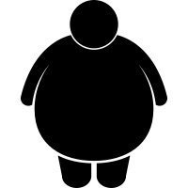
We can estimate whether someone is overweight or obese by calculating BMI ( Body Mass Index), and classify as follows:
Overweight - BMI >= 25kg/m²
Obesity - BMI >= 30kg/m²
Computation of BMI
Weight in kg divided by the square of height in square meters
BMI =
Weight (kg) Height (m²)
BMI Classification
Classification | BMI(Kg/m²) | Action
Underweight | <18.5 | Rehabilitation with therapeutic foods, counselling on intake issues and possible metabolic issues.
Normal range | 18.5 – 24.9 | Nutritional counselling, exercises to build muscles.
Overweight (pre-obese) | 25.0-29.9 | Nutritional counselling to reduce energy intake, physical activity to reduce weight
Obese | 30.0+ | Counselling to change lifestyle and reduce energy intake, physical activity to reduce weight refer to nutritionist
Source: WHO Classification of BMI

Slide 28
Activity: 1
BMI Calculation
Weight measurement
Demonstrate to the participants how to measure weight
Height measurement
Demonstrate to the participants how to measure height
BMI calculation
Calculate BMI using the findings
Waist Circumference
The waist circumference is taken at the position of the navel
Waist circumference is an indicator of intra-abdominal fatness and a good indicator of abdominal fat
A high waist circumference is associated with an increased risk for high blood pressure, diabetes mellitus, high cholesterol and cardiovascular disease.

Slide 29
Procedure: Take the measurement,
Without or with minimal clothing, directly on the skin
Midway margin lower rib and upper side hip
At the end of a normal expiration
With the arms relaxed at the sides
Measure twice and record average
Interpret results of measurement as shown.
Male | Women | Interpretation
<94cm | <80cm | Normal
94-102cm | 80-88cm | Increased risk
>102cm | 88cm | High risk

Slide 30
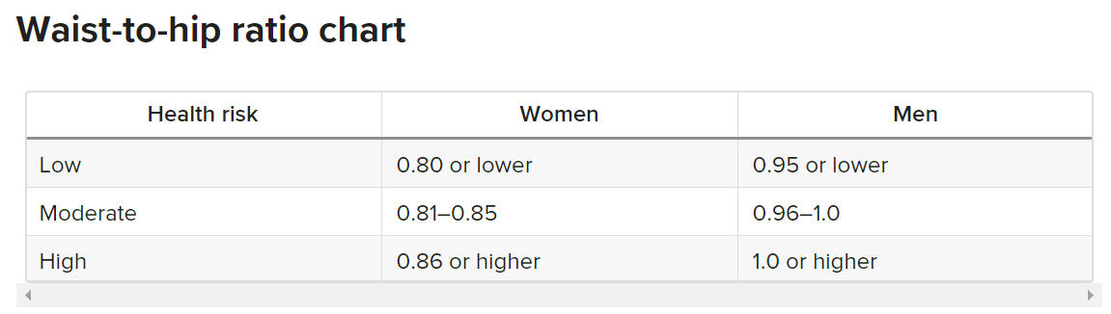
Waist-hip ratio
This is a way of measuring where body fat is stored.
A high waist-to-hip ratio indicates an increased risk of obesity-related health problems.
Waist-to-hip ratio is calculated by dividing the measured waist circumference by the measured hip circumference.
Waist = Waist-to-hip ratio(WHR) Hip
Indicators of risk
Women: WHR Greater than 0.85
Men: WHR Greater than 1.0

Slide 31
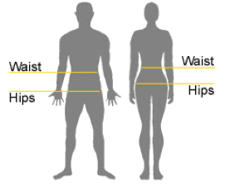
Activity: 2
Waist circumference measurement
Demonstrate how to measure the waist circumference
Divide the participants in groups of 5 persons
Each group to have a tape measure
Let the participants measure the waist and hip and compare the ratios

Slide 32
Physical Activity and Hypertension
Examples of simple physical activities one can engage in:
Playing with the children
Walking instead of using a motorbike or vehicle
Working in the garden
Household chores e.g. cleaning the house, washing clothes
Take the stairs instead of the elevator/lift.
Taking a brisk walk (walk at a fast pace)
Swimming
Dancing
Jogging

Slide 33
Lifestyle Modification
Take the following steps to prevent high blood pressure or to control or lower your blood pressure if it is too high.
Cook and eat with less salt (Do not add salt on the table)
Engage in physical activity for at least 30minutes for most days of the week and ensure you sweat
Aim for a healthy weight (achieve the right weight for your height)
Eat more vegetables and fruits
Stop the use of tobacco/tobacco products and reduce or stop alcohol
Ensure you have less stress in your life or find ways to manage the stress
If you are at high risk of developing hypertension, make sure you get regular medical check-up

Slide 34
UNIT 5
Facilitating the management of hypertension
Duration: 2 hours
Identify and manage people with hypertension
It is the role of the participant to screen Household members for high blood pressure, refer and support in the management of hypertension.
Participants will be expected to conduct assessment and screening of people for high blood pressure during household visits and other community interactions.
In order to identify people with high blood pressure and help people with hypertension, the following steps should be followed:
Introduce your intentions to the client
Measure the blood pressure of the client.
Show him/her the risk factors on the job aid and ask him or her to tell you if he/she is at high or low risk.

Slide 35
Inform the client your findings.
Record the results
If the BP is in the normal range, counsel on prevention measures

Slide 36
Risk assessment job aid
Risk Profile Questionnaire
Question | Your answer
1. Are you over 40 years of age?
2. Do any members of your family have hypertension. heart disease, a stroke or diabetes?
3. Do you do less exercise than you feel you should?
4. Would you describe yourself as overweight?
5. Do you eat a lot of salt or lots of processed food?
6 . Do you usually eat fatty foods?
7. Do you smoke?
8. Do you drink more than two alcoholic drinks a day?
9. Do you have a lot of stress in your life?
10. Do you feel you have a problem in managing stress?
Total number of “yes” answers
6 or more “yes··answers = high risk. 3 - 5 yes answers = moderate risk. 0 - 2 yes answers = low risk.
Remember this is only a “risk” assessment.It won’t tell you whether you do,or you don’t have hypertension. The best way to make sure is to have your blood pressure tested,and ask the health professional to explain what the reading means.

Slide 37
Client paths and their interaction with CHWs
In order for the client to have a confirmed diagnosis of Hypertension they require multiple elevated blood pressure readings over a period of time – typically 2-3 months. Therefore it is essential that as a CHW you assist with this process and ensure the client receives the correct number of readings and is correctly linked to the health facility.
As a CHWs, all clients you encounter that have an elevated BP reading (top or bottom reading is equal or higher than systolic 140 or diastolic 90 mmHg) are likely to follow three possible paths (see chart on next slide):
Client Path 1: These are the clients who have an elevated BP reading on visit 1, and you refer to a health facility, and are able to attend the appointment.
Client Path 2: These are those clients whom you find have an elevated BP reading on visit 1, but due to various reasons, the clients are unable to attend the clinic day as advised by you, and whom you schedule to come back and do a second reading on a different day within a month.

Slide 38
Client Path 3: These are those clients whom you found to have an elevated BP reading on visit 1, you referred them to the facility for a facility level BP recording and further evaluation, and have now been sent back to you for a 3rd reading at the community. For these types of clients, you are required to do the third BP reading and then refer them back to the facility. Since these clients will have already been issued with an Appointment Card (at the NCD Clinics) at the facility, all BP reading should be recorded in the clients’ booklet.
For all clients, on any visit, if either the top or the bottom numbers is higher than systolic 180 or diastolic 110 mmHg, refer the client to the health facility immediately.
In order to do this there are several paths that the client may take. It is important that each reading is captured in the clients patient booklet as well as the screening register. You must follow up with clients on a regular basis to ensure they have a blood pressure reading at least once a month (by you or the health facility) and ensure you continue to follow up with the client once diagnosed to ensure they are following lifestyle changes and taking medicine as required.

Slide 39
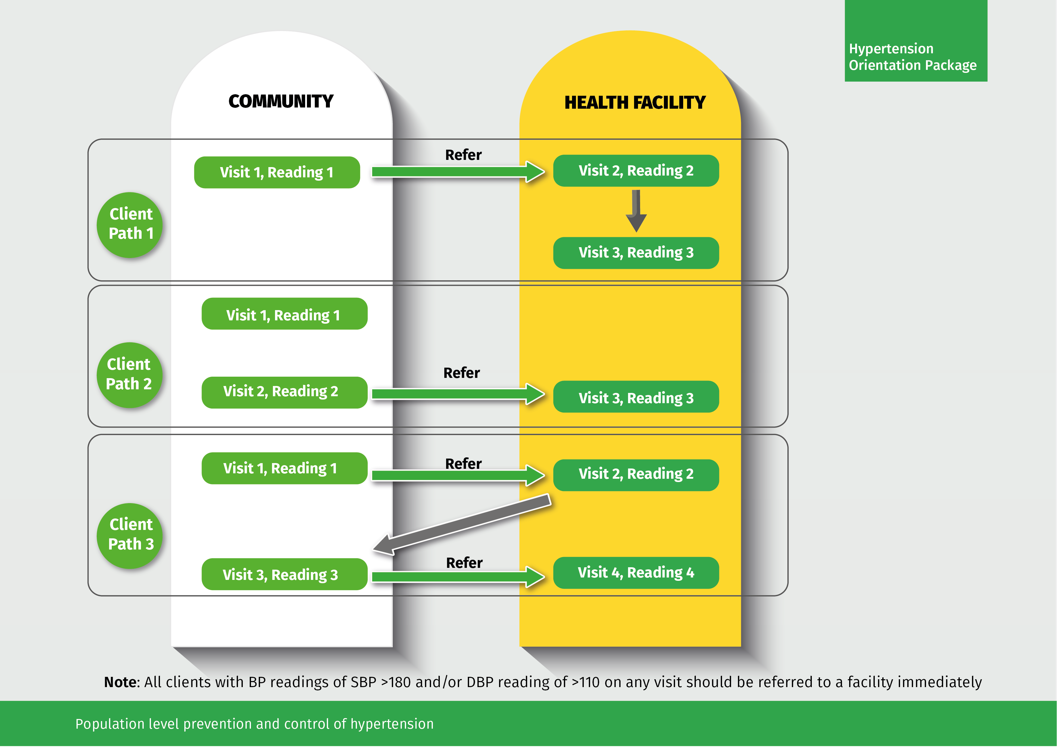

Slide 40
Referral
When taking blood pressure always consider the second BP measurement.
If blood pressure reading is equal or higher than systolic 140 and/or diastolic 90 mmHg, refer the client to the health facility
All clients with BP readings of SBP >180 and/or DBP reading of >110 on any visit should be referred to a facility immediately
Follow-up and Defaulter tracing
Visit the client to confirm that they went to the health facility
Also, follow-up to ensure clients are adhering to the healthcare worker’s recommendations
Remind clients with hypertension to be checked their blood pressure regularly
Remind the clients and/or care giver to visit the health facility as advised by the health provider.
Educate family members on hypertension and the importance of adhering to treatment.

Slide 41
Adherence
Treatment adherence means taking medication exactly as prescribed, and not missing any doses.
Important information about medication
Know the name of the hypertension medicine and keep the package
Do not miss clinic appointment
Carry medication and appointment card while travelling
As a participant, always inquire why the client isn’t adhering to treatment and give feedback to the healthcare worker.

Slide 42
Activity: 1
Addressing barriers to adherence
GROUP WORK: 10 minutes
Brainstorming on barriers of adherence to treatment
Frequently asked questions on adherence to hypertension treatment:
Before you start treatment, be certain you’re committed to taking medications every day as directed. Talk to your health care provider about any issues that may make adherence difficult:
Question: How do other medications I’m taking interact with my hypertension treatment?
Answer: This will be best answered by the health worker on your next visit to the health facility because every medicine reacts differently
2. Question: I missed a dose of my medication, what can I do?
Answer: If you forgot to take a dose, take immediately you remember if it’s a once per day dose, if its more doses per day the await the next dose.
3. Question: Can I share medicine with another client?
Answer: No, this is not allowed

Slide 43
4. Question: What will I do if I feel sick after taking the medicine?
Answer: This will be best answered by the health worker at the health facility because every medicine reacts differently
Question: I have been taking the medicines for so long, can I try herbal medicine which can cure me?
Answer: Herbal medicines do not cure hypertension, it is important to adhere/ comply with your schedule to make the medicine effective
Defaulter tracing
A defaulter is a client who is either not adhering to the prescribed management; or is not adhering to the health facility’s appointments.
It is the role of the CHWs to keep record of clients in his/her assigned households and advise them to adhere the prescribed management.
The CHW is the link between the community and the health facility. The health facility should share the list of the defaulters with the CH.

Slide 44
Activity: 2
Role Plays
Role Play 1:
Fatou has been diagnosed with Hypertension and is not interested in taking her tablets. She does not believe they will help her. Her mother has seen this and asks you to speak to her.
Role Play 2:
Lamin is feeling sick after taking his hypertensive treatment and decides to skip days in the week. His girlfriend asks you to speak to him.
Role Play 3:
Binta is busy and is going away on a trip. She always forgets her medication. How can you help her?
Role Play 4:
Muhammed was recently diagnosed with Hypertension. His employer is aware. Abdou does not want to take his tablets because he is worried what other’s will think at work and might think he has HIV. His employer asks you to talk to him?

Slide 45
Activity: 2
Role Plays
Role Play 5:
Omar complains of a headache. You check his blood pressure. It is 180/110. What will you do?
Role Play 6:
Mr. Kawsu gets dizzy at work. You check his blood pressure. It is 140/95. What will you do?
Role Play 7:
Mrs Sainabou is pregnant. Her legs are swelling. What will you do?
Role Play 8:
Fatima has difficulty with her sight. Every now and then everything gets blurred. She also gets severe headaches. You check her blood pressure. It is 130/90. What will you do?

Slide 46
Activity: 3
Case Study
Awa is a 30 year old woman whose father died of a heart attack when he was 58 years old. He smoked 60 cigarettes a day and was obese and loved adding salt to the food when he ate. His father had high blood pressure and took medication for years. What will you say to Awa?
Junkung is a fit young man of 35 years. He exercises at least 3 times a week and does not smoke. He drinks only on the weekends. His mother has hypertension and attends the clinic monthly.
What will you say to Junkung?

Slide 47
UNIT 6
Reporting
Orientation to data collection tools
Orientate CHWs on data collection tools
Submit monthly reports to the sub-district leader
Add number of hypertensives on the white Board

Slide 48
References

